Slide 1
ANIMALGAN: PREDICTIVE TOXICOLOGY USING GANS
Team members:
Abdulrahman Alkinani
Mythri Popuri
Sai Rahul Reddy Bapuram
Shabana Syed
Srichandan Kota
Venkata Sai Prashanth Pilla

Slide 2
OBJECTIVES
Aim : Creating and enhancing the Generative Adversarial Network(GAN) framework to generate synthetic data in toxicology.
Key Objectives:
Using existing Data to Simulate experimental scenarios.
Augment datasets while preserving statistical properties.
Analyze performance using metrics like RMSE, Cosine Similarity, and KS-Test.

Slide 3
Problem Statement
Understanding and predicting drug-induced toxicity is a critical challenge in pharmaceutical research. Traditional methods rely on animal testing, which is resource-intensive and often limited in scale. The key problems addressed include:
Drugs Under Study: Aspirin, Diclofenac, Indomethacin, Meloxicam, Ibuprofen, and related compounds.
Data Gaps: Scarcity of large-scale, high-quality datasets for toxicity prediction.
Impact: Identifying molecular features responsible for liver toxicity and other adverse effects to aid in drug design.

Slide 4
DATA PIPELINE
Steps:
Data Collection (e.g., Open TG-GATEs, GIThub ).
Drugs Names:
1.aspirin
2.diclofenac
3.indomethacin
4.meloxicam
5.ibuprofen
6.naproxen

Slide 5
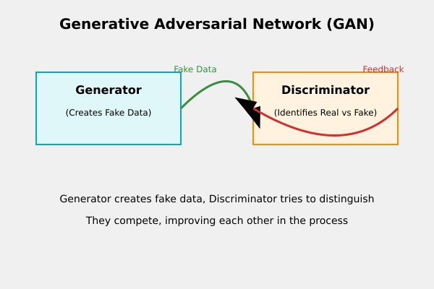
Introduction to GANs and Its Role in Our Project
What are GANs? Generative Adversarial Networks (GANs) are machine learning models consisting of two neural networks:
Generator: Creates synthetic data.
Discriminator: Differentiates real from synthetic data. Both networks train together in an adversarial process, producing realistic synthetic data.
Why GANs for Our Project?
Data Expansion: Generates synthetic toxicological data to overcome limited real-world datasets.
Complex Relationships: Captures nonlinear patterns between molecular features, treatments, and toxicity.
Enhanced Modeling: Provides additional training samples, improving model accuracy.
Ethical & Cost-Effective: Reduces reliance on animal testing while lowering costs.

Slide 6
IMPLEMENTATION PROCESS
Parallel and Sequential Architecture Design:
Built models simultaneously to explore optimal designs.
Adjusted hyperparameters dynamically for stability.
Technical Aspects:
Used CWGAN-GP for conditional synthetic generation.
Key Parameters:
Latent Dimension: 1828
Batch Size: 128
Epochs: 100,000

Slide 7
Datasets
1. Example_Data_training.tsv
Purpose: Provides real clinical pathology data (e.g., ALT, AST, TBIL) for training the AnimalGAN model.
Usage: Establishes relationships between drug treatments, doses, and exposure durations for synthetic data generation.
2. Example_MolecularDescriptors.tsv
Purpose: Contains molecular descriptors representing the chemical structure of compounds.
Usage: Enhances predictions by linking molecular features to toxicological outcomes.
3. Example_Treatments_test.tsv
Purpose: Real clinical pathology data for testing and validation of the AnimalGAN model.
Usage: Evaluates the model's ability to predict toxicity for new compounds and scenarios.

Slide 8
Data Preprocessing
Data Collection: Obtained datasets from OpenTG-GATES, focusing on treatment conditions and molecular information for selected drugs.
Data Cleaning: Addressed missing values, removed duplicates, and filtered irrelevant fields to prepare the data for modeling.
Feature Scaling: Normalized molecular descriptors, dosage levels, and sacrifice periods for uniformity.
Input Structuring: Converted features into PyTorch-compatible tensors for seamless GAN model integration.
Model Training: Trained the GAN model on ~300 records over 100,000 epochs, generating 60,000 high-quality synthetic records.

Slide 9
ORIGINAL GAN MODEL : Model Architecture
Generator Architecture
Design: The Generator uses a series of dense layers, with each block consisting of a linear transformation followed by batch normalization and a LeakyReLU activation function. This setup helps in handling the complex and high-dimensional nature of the input data.
Layer Configuration:
A substantial initial layer with 4096 neurons to process concatenated inputs (noise + structural, time, and dose data).
The network progressively reduces the complexity through layers with decreasing neurons (2048, 1024, 256, and finally 64).
The output layer uses a Tanh activation to normalize the output to the range of [-1, 1], suitable for many types of generated data.
Discriminator Architecture
Setup: The Discriminator architecture mirrors a typical feed-forward design but focuses heavily on feature discrimination, crucial for GAN performance.
Layer Details:
Starts with a large input layer of 2048 neurons that receives concatenated real or generated data along with condition variables.
Includes several dropout layers interspersed with LeakyReLU activations to prevent overfitting and help the model generalize better across diverse data samples.
Ends with a single neuron output to classify inputs as real or generated.
Functional Overview
Data Processing:
Generator: Combines noise with conditional inputs to produce synthetic data, modeling complex dependencies within the data.
Discriminator: Evaluates the authenticity of data by classifying it as real or synthetic, guided by its ability to distinguish subtle features in the input.

Slide 10
ORIGINAL GAN MODEL : Training
Specifics of Gradient Penalty Calculation
Gradient Penalty Mechanics:
Calculates the gradient penalty by first creating interpolations between real and generated samples using a weighted combination where weights are sampled from a uniform distribution.
The discriminator evaluates these interpolations, and the gradients of these evaluations with respect to the interpolations are computed. The norm of these gradients is then enforced to be close to 1, which is a critical condition for the Wasserstein GAN with gradient penalty, promoting training stability.
Detailed Training Cycle
Discriminator Training Details:
In each training iteration, the discriminator is trained first. It processes both real data and fake data generated by the generator, calculating losses for both. The objective is to maximize the difference (Wasserstein distance) while incorporating the gradient penalty to maintain the Lipschitz constraint.
Generator Training Dynamics:
The generator is updated less frequently than the discriminator, typically every nth iteration as defined by n_critic. Its training involves generating data that aims to minimize the discriminator's ability to distinguish it from real data, effectively training the generator to improve its data synthesis capabilities.
Loss Calculation:
For the discriminator: Combines the losses from real and generated data and integrates the gradient penalty.
For the generator: Aims to fool the discriminator by maximizing the error in its judgments.

Slide 11
ORIGINAL GAN MODEL : GAN Dataset Generation
Scaling and Data Preparation
Feature Scaling:
Utilizes MinMaxScaler to normalize molecular descriptors and physiological parameters like SACRI_PERIOD (sacrifice period) and DOSE_LEVEL to a range of [-1, 1], which aligns the feature scale with the activation function's range in neural networks.
Noise Injection and Synthetic Data Creation
Random Noise Generation:
Generates Gaussian random noise with torch.randn(), which is crucial for introducing variability in the synthetic data, thereby preventing the model from outputting identical results for different inputs.
Data Concatenation and Generation:
Concatenates the scaled treatment data with noise vectors. This composite input is then fed into the generator, which processes it through a deep neural network to output synthetic molecular measurements mimicking real data characteristics.
Output Rescaling:
Applies inverse scaling to the generated synthetic data using MinMaxScaler.inverse_transform(), converting it back to the original measurement scales, making it directly comparable to real-world data.

Slide 12
MODEL A : Model Architecture changes done
Refined Generator Architecture
Normalization Adjustments: Shifts from Batch Normalization to Layer Normalization within each block, better suited for the smaller batch sizes expected from the limited drug dataset. This helps maintain consistency in normalization across different parts of the model irrespective of batch size.
Simplified Network: Reduces the complexity of the network by lowering the number of neurons in the largest layer from 4096 to 2048 and adjusting subsequent layers accordingly. This reduction aims to prevent the model from overfitting to the small dataset.
Streamlined Discriminator Architecture
Capacity Reduction: Scales down the architecture to start with 1024 neurons and reduces further through the network, aligning the discriminator’s capacity with the simpler generator output, ensuring that both models train at compatible rates.
Regularization Tuning: Adjusts the dropout rate from 0.4 to 0.3, optimizing the trade-off between learning detailed features and maintaining robustness to input variations.
Overview of Adaptations
Focus on Efficiency and Stability: Both the generator and discriminator are tailored to efficiently handle smaller, more specific datasets without losing the ability to generalize, which is critical for generating high-quality synthetic drug data.
Optimization for Specific Data Traits: Both models are carefully adjusted in terms of architecture depth and width to better capture the underlying patterns in the smaller dataset, aiming for an optimal balance between model complexity and dataset size.

Slide 13
MODEL A : Training changes done
H/W Infrastructure Used : 8 NVIDIA H100 GPUS Enhanced Gradient Penalty Implementation
Improved Interpolation and Penalty Calculation:
Adjusts the interpolation method to better suit the characteristics of the dataset, possibly by modifying how the interpolation weights are sampled or by adapting the strictness of the penalty based on observed training dynamics.
Advanced Training Loop Adjustments
Optimized Discriminator and Generator Update Frequency:
Modifies the frequency of updates to the discriminator and generator based on empirical observations of their training performance, potentially introducing dynamic adjustment mechanisms based on real-time performance metrics.
Enhanced Loss Functions:
Introduces additional terms or modifies existing components of the loss functions to better capture the nuances of the dataset, such as incorporating terms that address specific challenges observed in earlier training epochs.
Implements targeted regularization strategies in both the discriminator and generator to mitigate overfitting and promote generalization, potentially using techniques like dropout or spectral normalization.
Systematic Debugging and Output
Detailed Monitoring and Feedback:
Incorporates more detailed logging of intermediate training states and loss components, allowing for deeper insights into the training process and facilitating more targeted adjustments.
Employs conditional logging to capture specific events or thresholds, enhancing the ability to respond to anomalies in training behavior dynamically.

Slide 14
MODEL A : GAN Dataset Generation file changes done
Wider Validation Range:
The conditional checks for validating generated data are adjusted to a broader range, if 50 < check < 150. This modification likely aims to accommodate a greater diversity of data outputs or different tolerance levels in the evaluation of synthetic data's plausibility.
Introduction of Performance Timing:
The script now includes performance timing using time.time() at various points in the data generation process. This feature allows for monitoring the duration of operations, providing insights into the efficiency of the process and identifying potential delays or bottlenecks.
Optimized Data Compilation Method:
Instead of immediately converting each batch of generated data into a DataFrame, the script now collects all valid generated samples in a list. This approach minimizes memory usage and computational overhead during the generation phase. The list is converted into a DataFrame once all data generation is complete, enhancing efficiency, especially when handling large datasets.
Enhanced Real-Time Feedback:
The script includes additional print statements that offer real-time feedback on the generation process, including the validation check results and counts of successfully generated samples. These statements help in monitoring the generation process closely and adjusting parameters if necessary to improve output quality.

Slide 15
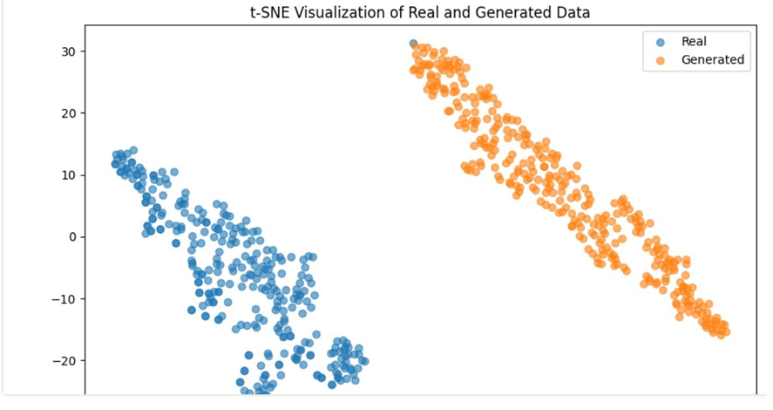
MODEL A - GAN - 1
Description of Results:
The t-SNE plot presents a clear separation between the real data (blue) and the generated data (orange). This visualization highlights the initial outcome of replacing the dataset in the GAN model without further optimization or training adjustments.
Observations:
Distinct Clusters: The real and generated data form distinct clusters, indicating that the GAN, at this stage, can differentiate between the two types of data but hasn't achieved convergence. The clusters suggest that the generated data, while successfully synthesized, differs significantly in feature space from the real data.
Lack of Overlap: The absence of overlap between the real and generated data points suggests that the current model parameters and the generator's ability to mimic the real data distribution need refinement to capture the underlying patterns more accurately.
Implications for Further Development:
The clear separation between clusters in this initial step indicates the necessity for further training cycles, hyperparameter tuning, and possibly model architectural adjustments to enhance the GAN’s ability to generate data that more closely resembles the real dataset.

Slide 16
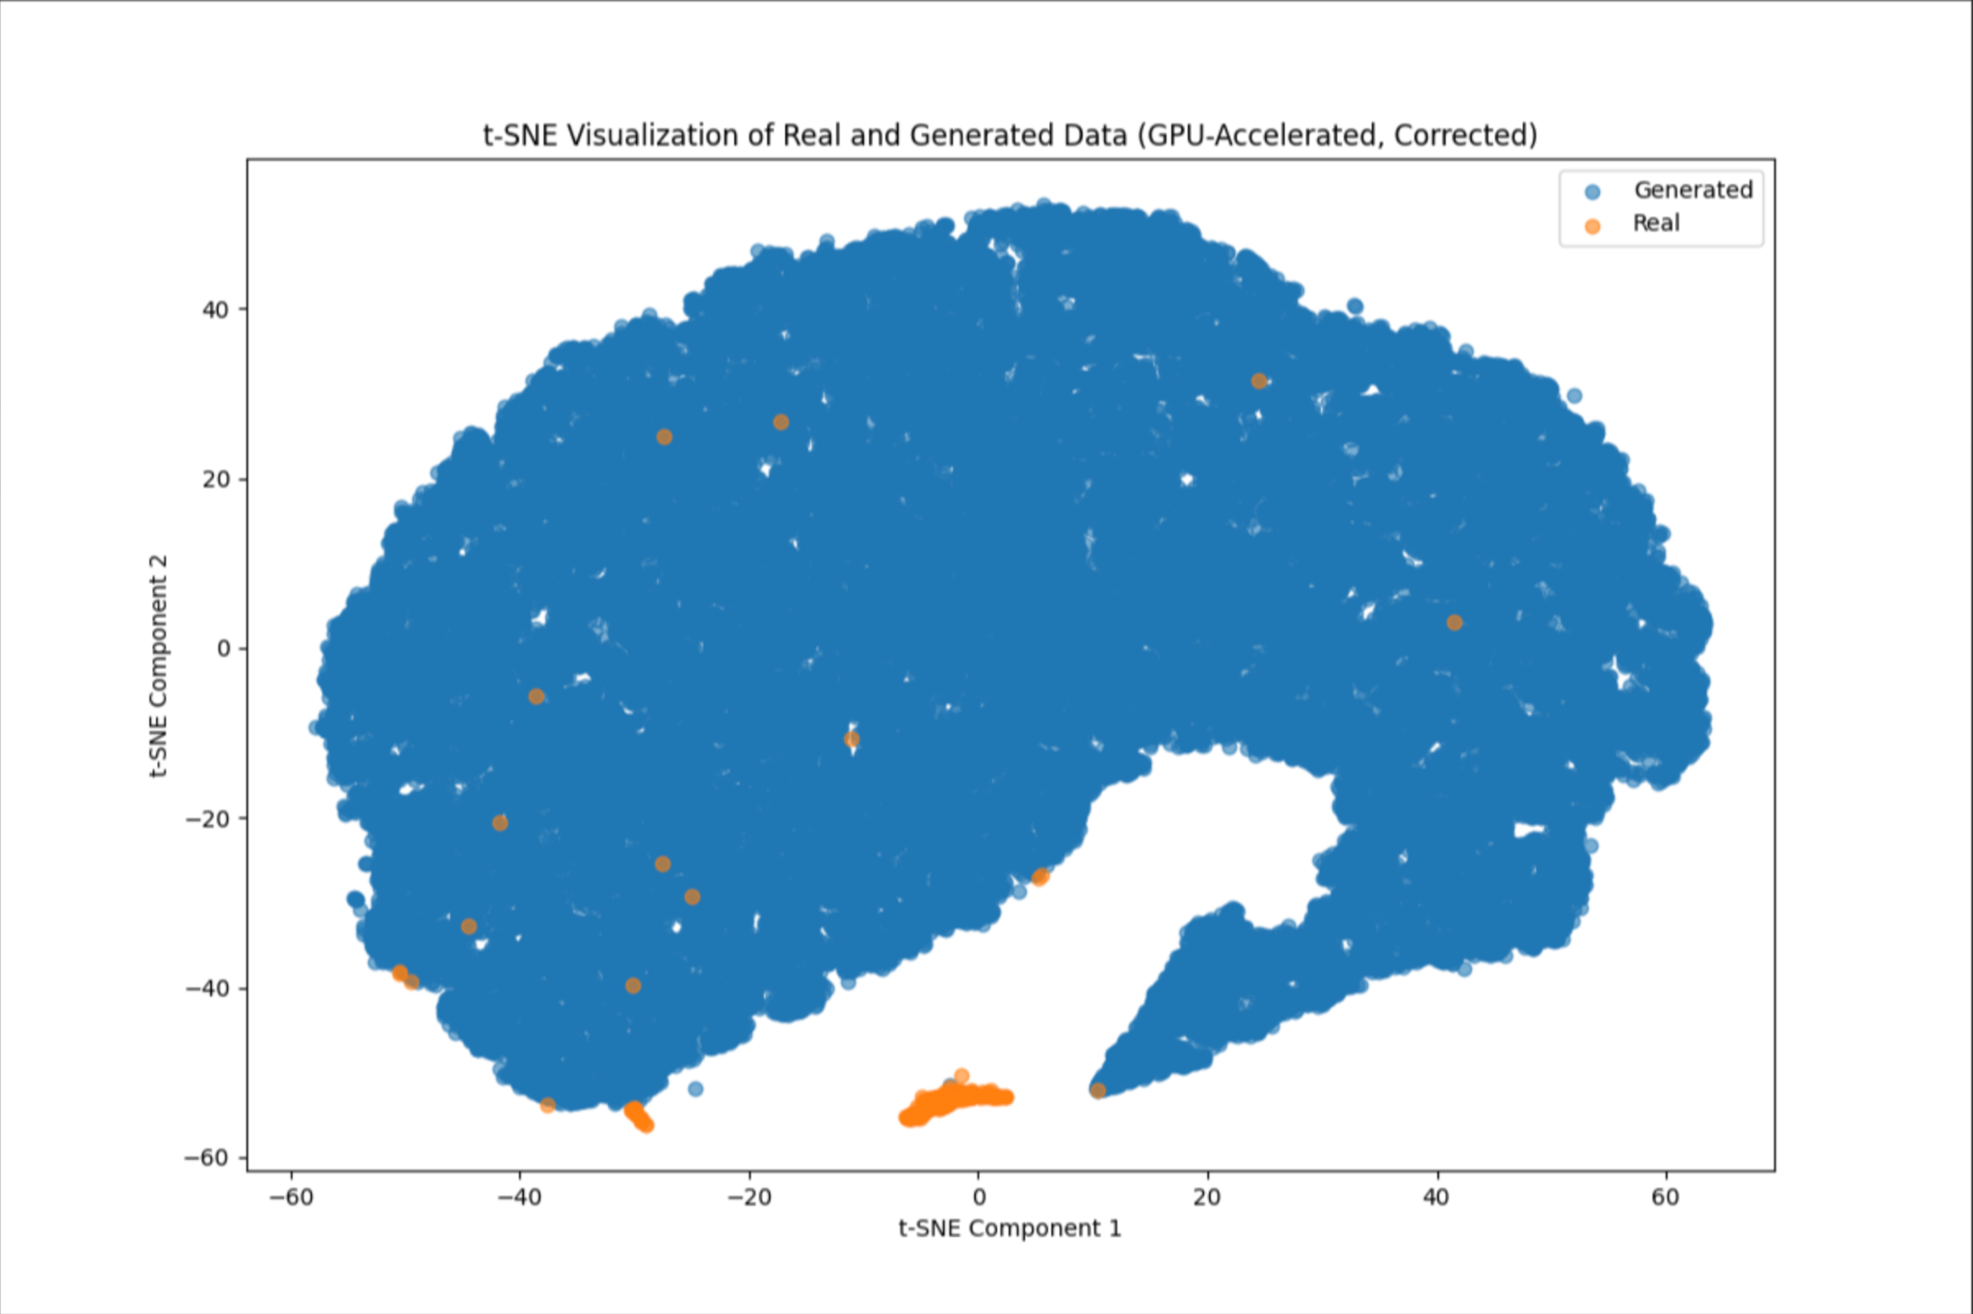
MODEL A - GAN - 2
Description of Results:
The t-SNE plot shows a significant improvement in the integration of real and generated data points. While the real data (blue) still forms a major backdrop, the generated data (orange) appears sporadically interspersed among the real points.
Better Integration: Unlike the clear separation seen in GAN 1, GAN 2 demonstrates a better embedding of generated data within the real dataset, indicating improved learning and generation capabilities.
Reduced Clustering of Generated Data: The generated data does not form isolated clusters and instead appears more evenly distributed. This suggests that the generated samples are starting to capture the variability and characteristics of the real data more effectively.
Changes in the Training Configuration:
Increased Epochs: Training duration was significantly increased to 5000 epochs, allowing the model more iterations to refine its parameters.
Adjusted Learning Rate and Batch Size: A lower learning rate and optimal batch size were configured to improve training stability and convergence.
Gradient Clipping: Introduced gradient clipping to both the generator and discriminator to prevent exploding gradients, a common issue in training deep generative models.
Regularization Techniques: Implemented a more sophisticated regularization strategy for the generator, ensuring diversity in the generated data while avoiding common pitfalls like mode collapse.
This phase, termed "GAN 2", showcases the advancements in training depth and model configuration, leading to notable improvements in data generation quality as evidenced by the visual blending of real and generated data points in the t-SNE plot.

Slide 17
MODEL A - GAN - 3
Command Line Configuration for GAN-3 Training
Epochs: Set to 5,000 to extend the training process, allowing the model to learn intricate patterns over a larger dataset.
Batch Size: Reduced to 16, facilitating more frequent updates and refined gradient calculations, which is crucial for stability in training Generative Adversarial Networks.
Learning Rate: Configured at 0.0005, this moderate rate ensures steady convergence without overshooting minima, balancing speed and accuracy in adjustments.
Critic Updates: The discriminator is updated once per generator iteration (n_critic=1), maintaining a balance between generator and discriminator learning.
Gradient Penalty (lambda_gp): Set to 10, significantly emphasizing the gradient penalty in the loss function to enforce smoother gradients, which helps in stabilizing the training of the discriminator.
Purpose and Impact:
These parameters are carefully chosen to optimize the generative model's ability to produce realistic and varied data, aiming to minimize mode collapse and improve the fidelity of generated samples.
The configuration leverages a disciplined approach to training deep learning models, ensuring each component is fine-tuned to address specific challenges encountered in generative modeling.
t-SNE Visualization Analysis:
Overview: The t-SNE plots showcase a visual analysis of real versus generated data distributions, assessing the generative model's performance in mimicking the true data characteristics.
Visualization: The generated data points are depicted in orange, while the real data points are in blue, providing a clear contrast.
Quantitative Metrics:
Mean Difference: 40.28, indicating the average distance between the centroids of real and generated data clusters.
Variance Difference: 1779.23, which reflects the dispersion difference between the two distributions.
T-Test Avg P-Value: 0.0002, suggests statistically significant differences in the means of the generated and real data.
Kolmogorov-Smirnov Test Avg P-Value: 0.0000, indicates significant differences in the distribution shapes.

Slide 18
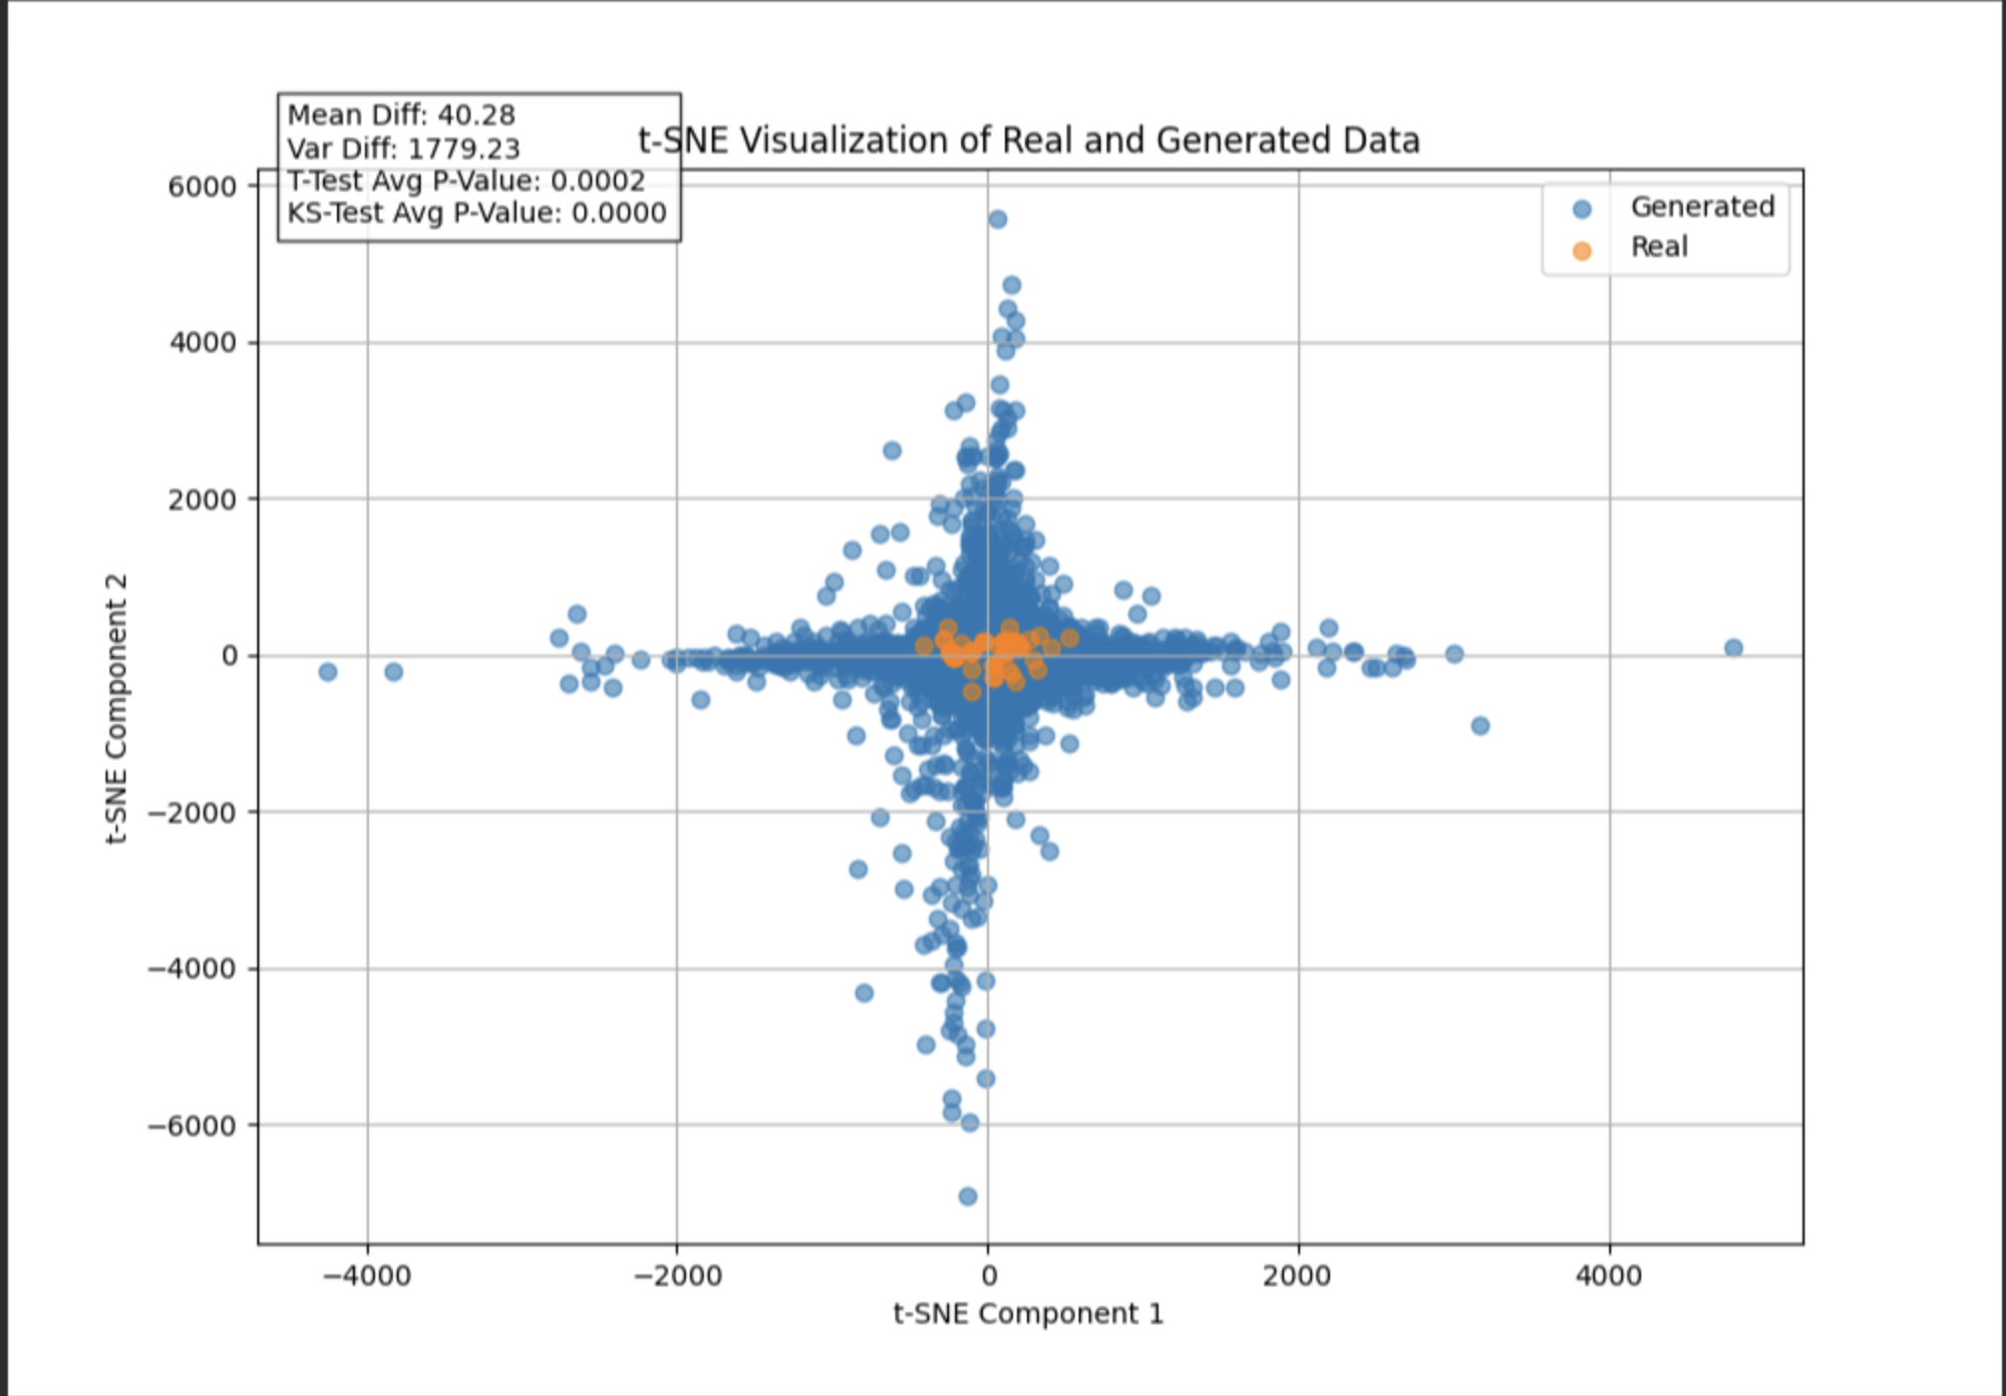
MODEL A - GAN - 3

Slide 19
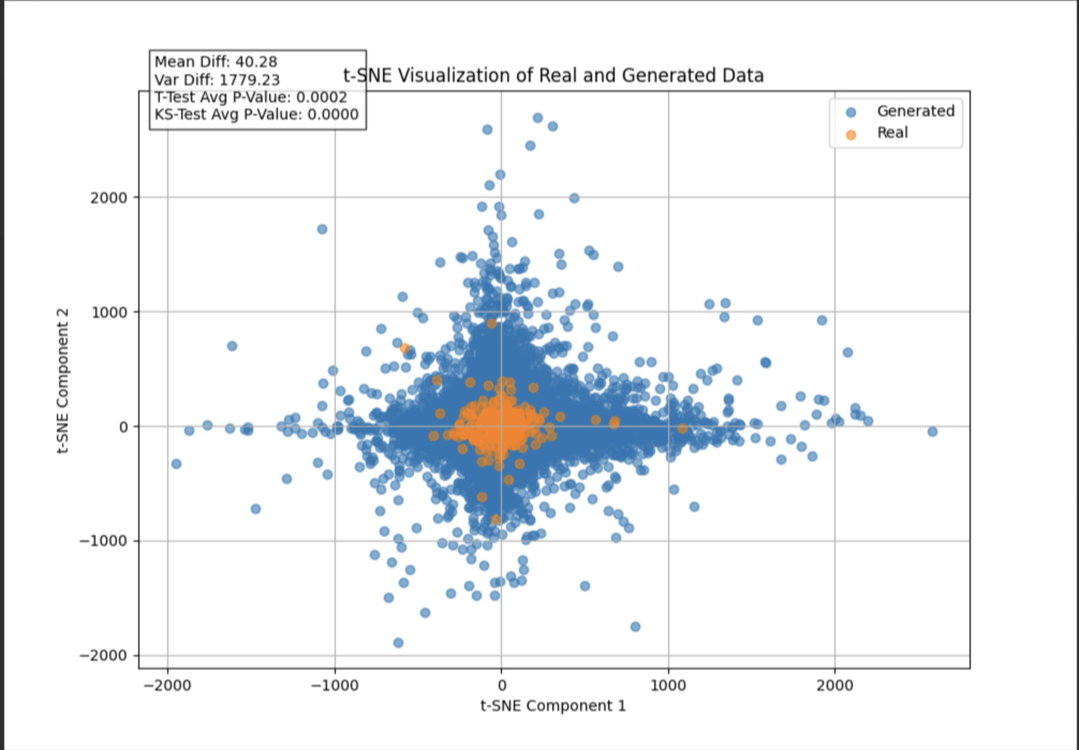
MODEL A - GAN - 3

Slide 20
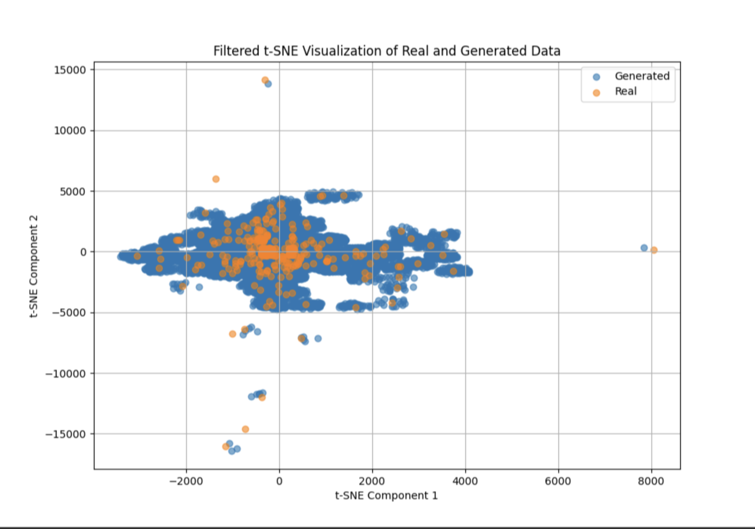
MODEL A - GAN - 3 - Filtered
Key Steps in the Filtering Process:
Distance Calculation:
Calculate the Euclidean distance between each generated point and the real data points to quantify similarity.
Thresholding for Outlier Removal:
Apply a 90th percentile threshold on the calculated distances to identify and retain the generated points that are closest to the real data.
t-SNE Visualization:
Utilize t-SNE to project the high-dimensional data onto two dimensions, focusing on comparing the 'Real' and 'Filtered Generated' data to demonstrate improved alignment and consistency.
Results: The filtered t-SNE plot shows a tighter clustering of generated data around the real data clusters, indicating successful removal of aberrant generated examples and enhanced data quality.
Implications: This advanced filtering enhances the model's utility by ensuring that the generated data more accurately reflects the characteristics of the real data, crucial for reliable applications and further model validation.

Slide 21
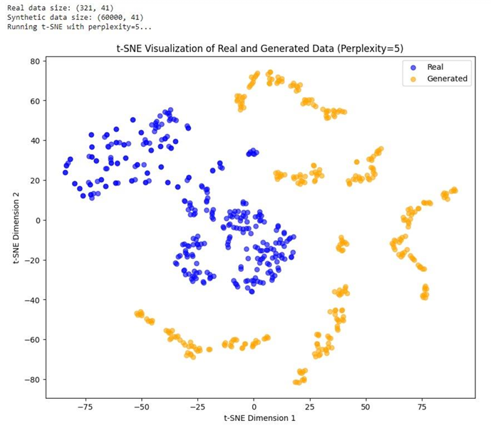
MODEL A

Slide 22
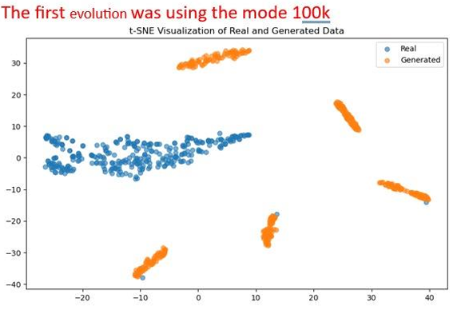
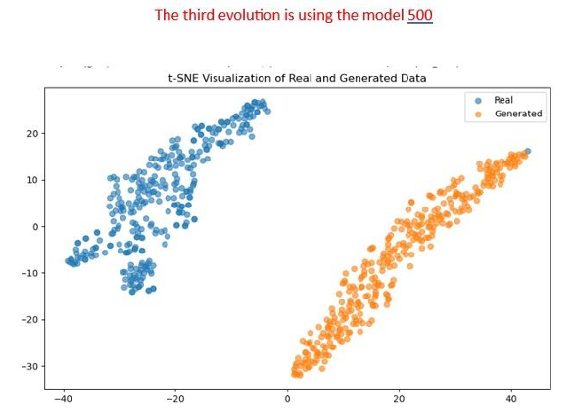
MODEL B:

Slide 23
Model Name - ToxiGAN
Pre-processed data into a TSV file containing 321 records for 5 drugs.
Modified molecular descriptor file using Python to create a large dataset.
Python for scripting and NVIDIA GeForce RTX 3080 for accelerated training.
Focused on maintaining data quality and structural integrity throughout the process
Convergence is a point where the generator produces data indistinguishable from real data, and the discriminator can no longer tell them apart.
Obtaining convergence has been a crucial part in building this model.

Slide 24
TRAINING
Real data and generated data are distinctly clustered, reflecting a lack of overlap or similarity.
Model has not yet achieved a meaningful convergence.
Need for proper parameter tuning to improve the model.

Slide 25
Parameter Tuning:
Learning Rate: −7 (Ensures efficient convergence)
Lambda_GR: 0.7 (Maintains structural properties)
Lambda_GP: 5 (ensures strong gradient penalty)
n_critic: 2 (Improves model stability)
Dropout Layers: 0.3 (Prevents overfitting)

Slide 26
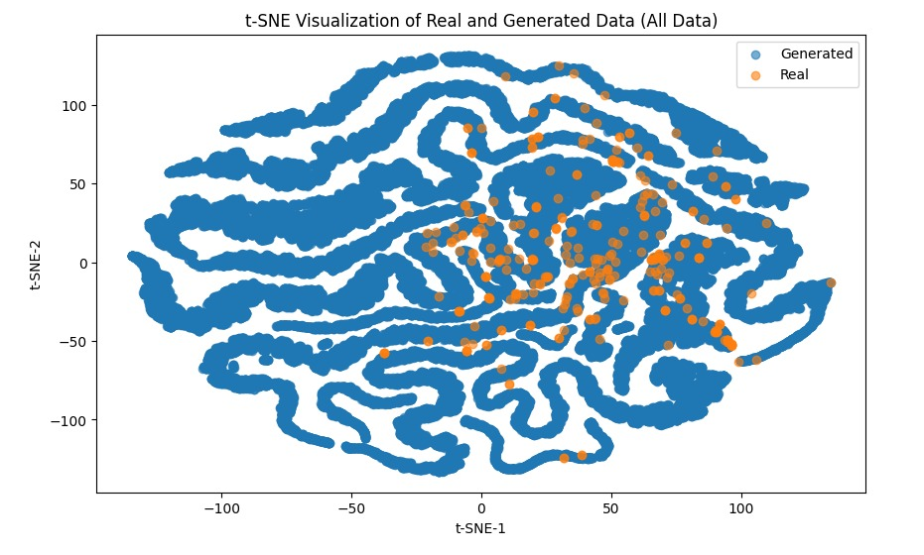
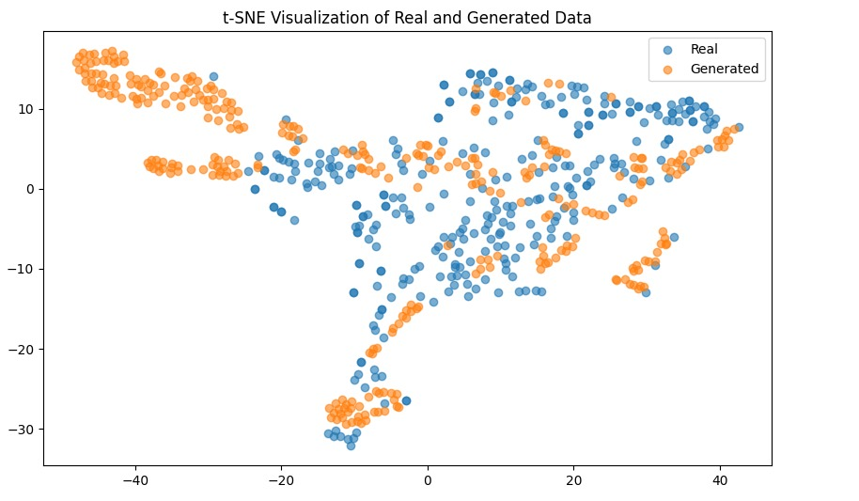
Initial Run
Used 10,000 epochs for baseline results. Generated data shows an initial structural and distributional alignment with gaps in the distribution.

Slide 27
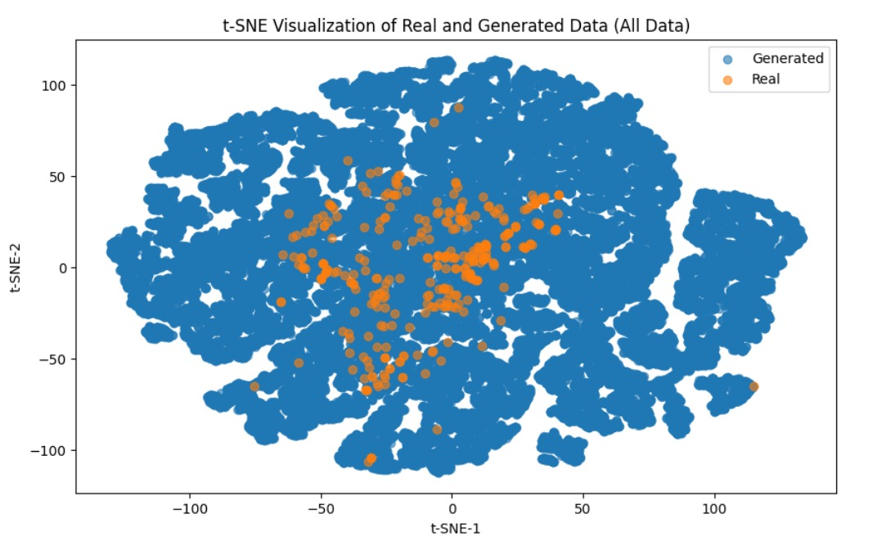
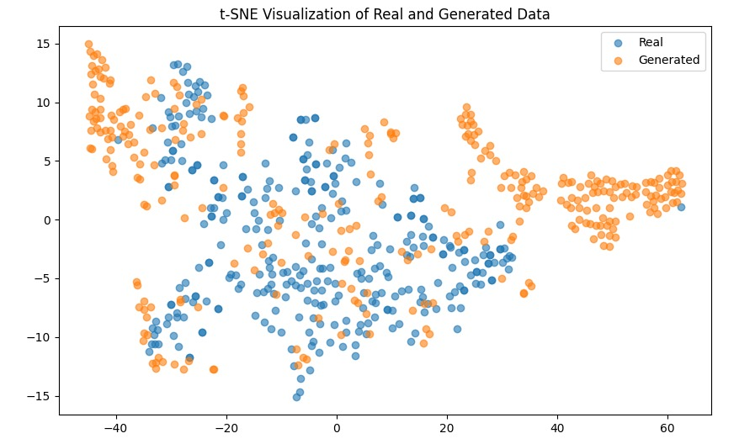
Extended Run
Used 100,000 epochs and generated data has improved similarity to real data.
Better alignment and higher model precision compared to 10,000 epochs.

Slide 28
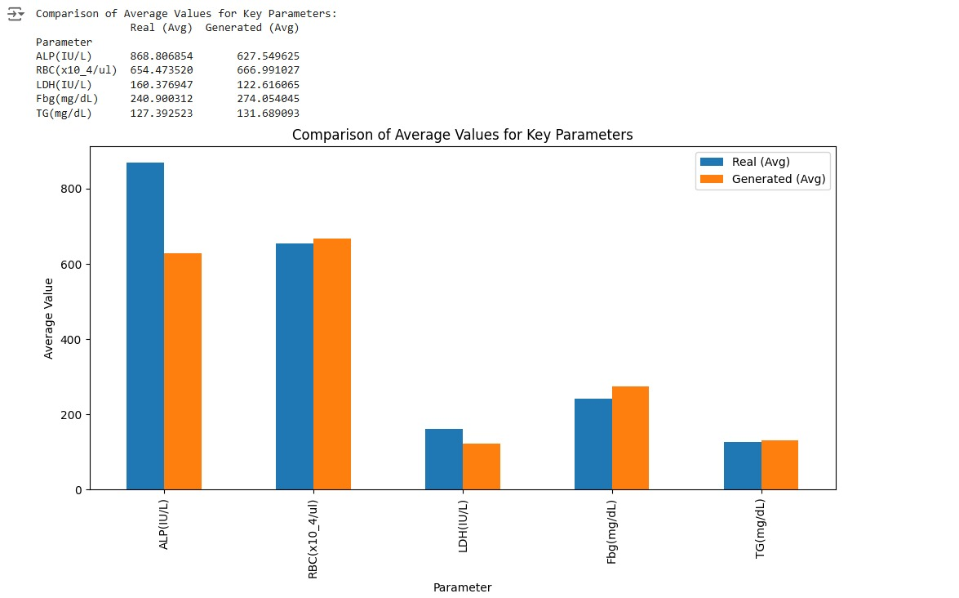
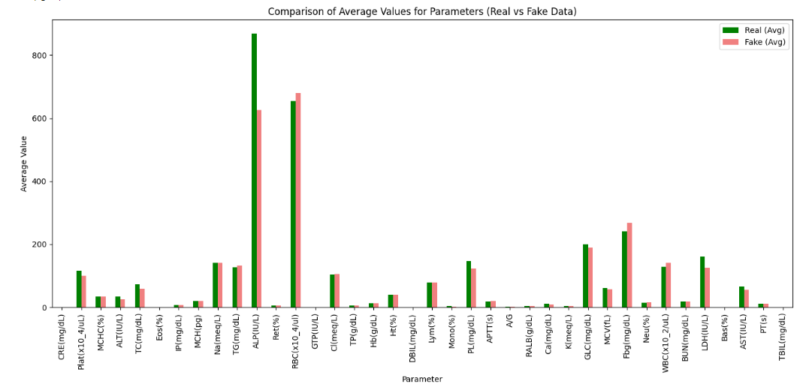
ANALYSIS
comparing the average values of key parameters between real and generated data.
average values are closely aligned.
Generated data effectively replicates the characteristics of the real dataset.

Slide 29
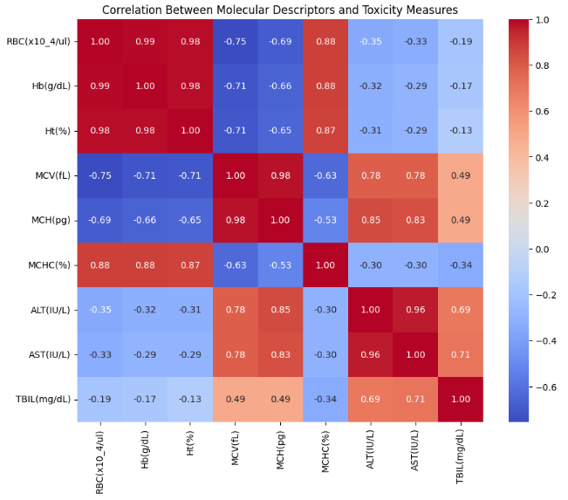
Co-relations:
RBC, Hb, and Ht are highly correlated (close to 1), indicating interdependence among these measures.
RBC and MCV exhibit a strong negative correlation (-0.75), suggesting inversely related effects.

Slide 30
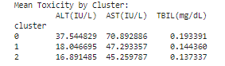
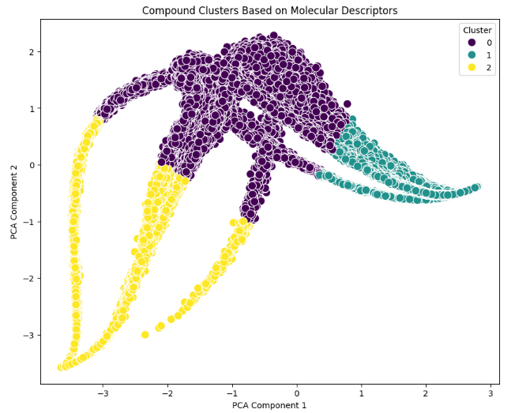
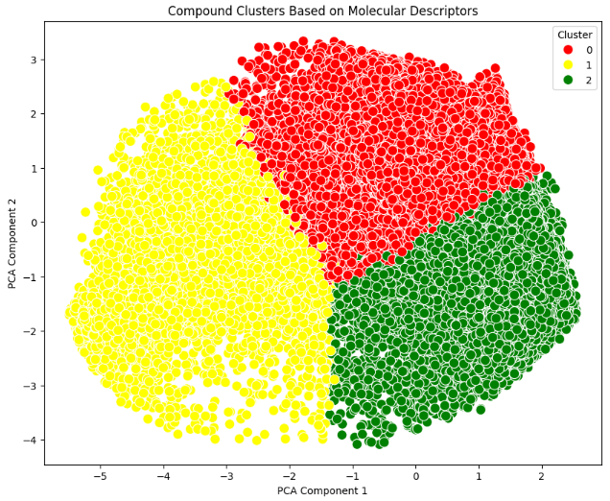
Toxicity clusters: With distinct characteristics in ALT, AST, and TBIL levels, these clusters highlight the diversity and corresponding toxicity measures.

Slide 31
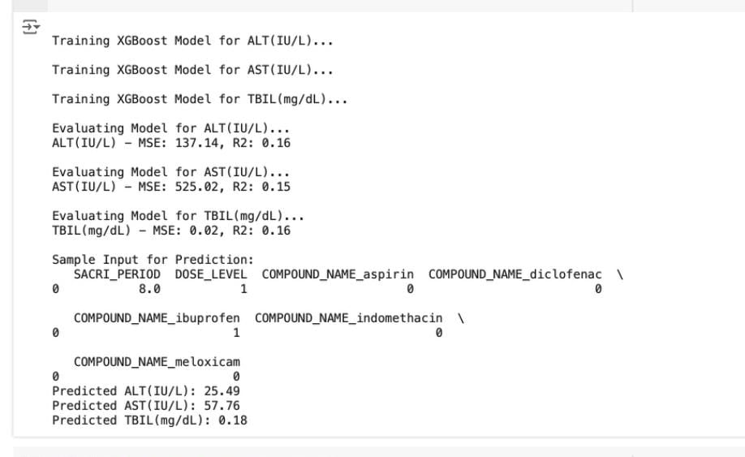
Predicting Toxic Levels using XGBoost
We tried to use both the drug molecular descriptor & the generated gan dataset and used the Compound_name, Dosage_level and Sacrifice_period and tried to predict the toxic levels - ALT, AST and TBIL.
We were able to predict the values but the model accuracy is too low for a couple of reasons:
Molecular descriptor dataset is too large & have various columns.
Still figuring out what can be done to improve the accuracy.
One possible solution is :
Perform PCA on the merged dataset & which will help us in dimensionality reduction and will be focusing on the key and important features only.

Slide 32
Future work
Our work of combining the molecular descriptor file with GAN-generated data opens up thrilling possibilities for the future.
we could uncover correlations between molecular structures and toxic levels.
The ultimate goal? Identifying what specific molecular structures could reduce or even eliminate toxicity - leading to the creation of entirely new, safer drugs.
Designing a new drug will basically be a scientific breakthrough!
Processing a dataset of this magnitude demands huge computational power which we lack right now.
But if an opportunity came along - we’d jump at it :)

